Slide 1

PROJECT EXHIBITION – 1 COURSE CODE – DSN2098 REVIEW-2

Slide 2
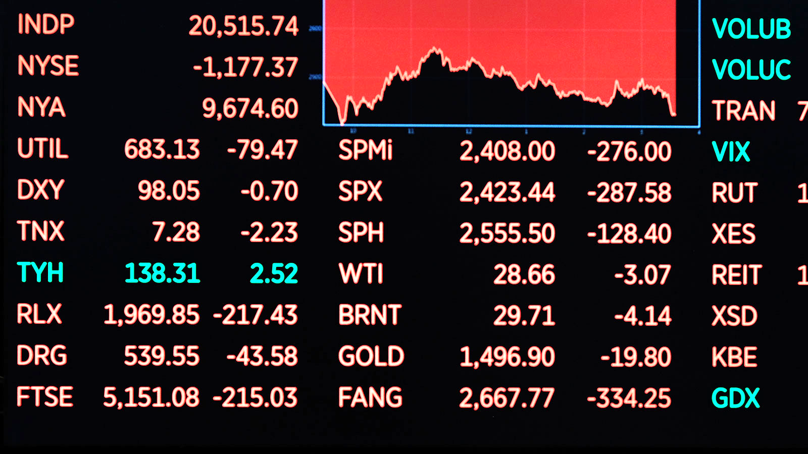
STOCK MARKET DATA AND ANALYSIS IN PYTHON
FACULTY- Dr. K MURUGESHWARI
GUIDE- Dr. VENKAT PRASAD PADHY

Slide 3
MEET OUR TEAM
JAHNAVI GADIPUDI
20MIP10040
SREEPRADA CHINTAGINJALA
20MIP10049
TELUGUNTI AKHIL
20MIP10045
VIVEK KUMAR SAHU
20MIP10042
MANOJ SEN
20MIP10022

Slide 4
PROBLEM STATEMENT
The stock market appears in the news every day. You hear about it every time it reaches a new high or a new low. The rate of investment and business opportunities in the Stock market can increase if an efficient algorithm could be devised to predict the short term price of an individual stock.
As in review-1 we have shown you how we will carry out this project so that you can analyze your favorite stock and can make the maximum profit from it.
Further , we will see if there is a possibility of presenting a model using graphs which will predict stock price with a less percentage of error. And if the answer turns to be YES, we will also see how reliable and efficient will this model be..

Slide 5

SYSTEM ARCHITECTURE DIAGRAM
YAHOO Finance Data
Trend
Continuous UP/DOWN
Volume Variation
PREDICTION
MODEL
trend>
threshold
TRUE
FALSE
UP
DOWN

Slide 6

MODULES IDENTIFICATION
IMPORTING DATA
IDENTIFYING TRENDS
DATA COLLECTION
PRE-PROCESSING

Slide 7
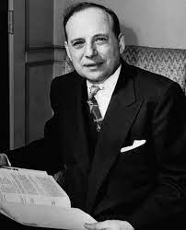
A QUOTES IS WORTH A THOUSAND WORDS
"The individual investor should act consistently as an investor and not as a speculator."
Ben Graham

Slide 8
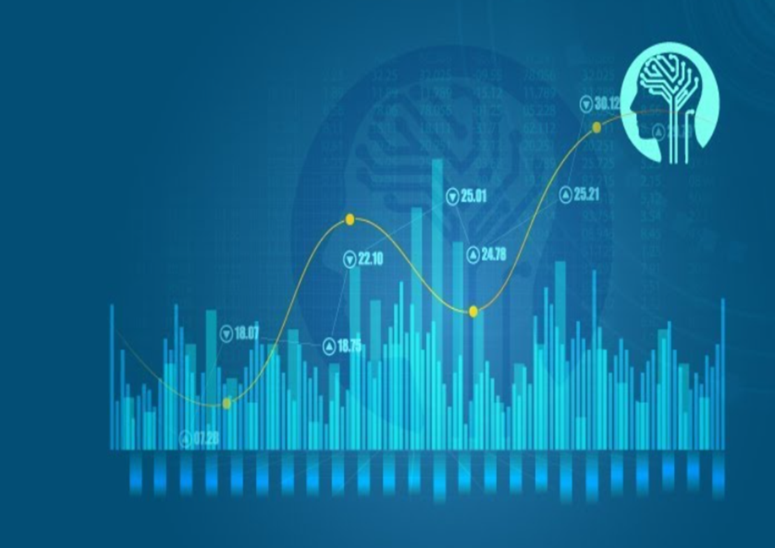
REFERENCES
The Python Bible Volume 5: Python For Finance (Stock Analysis, Trading, Share Prices)
STOCKER, MATPLOTLIB, Chrome Inspector (Dev Tools) etc.
https://towardsdatascience.com/stock-market-analysis-in-python-part-1-getting-data-by-web-scraping-cb0589aca178

Slide 9
THANKS!
Any questions?

